Slide 1


Intelligent Garbage Classification

Slide 2
Our mission
Empower every person and organization on the planet for smart garbage classification in their daily life, leveraging Microsoft’s Intelligent Cloud and Intelligent Edge.

Slide 3

Video

Slide 4
The impact

Slide 5
Shakespeare once said...
ToB, or ToC (not ToB), that is the question.

Slide 6
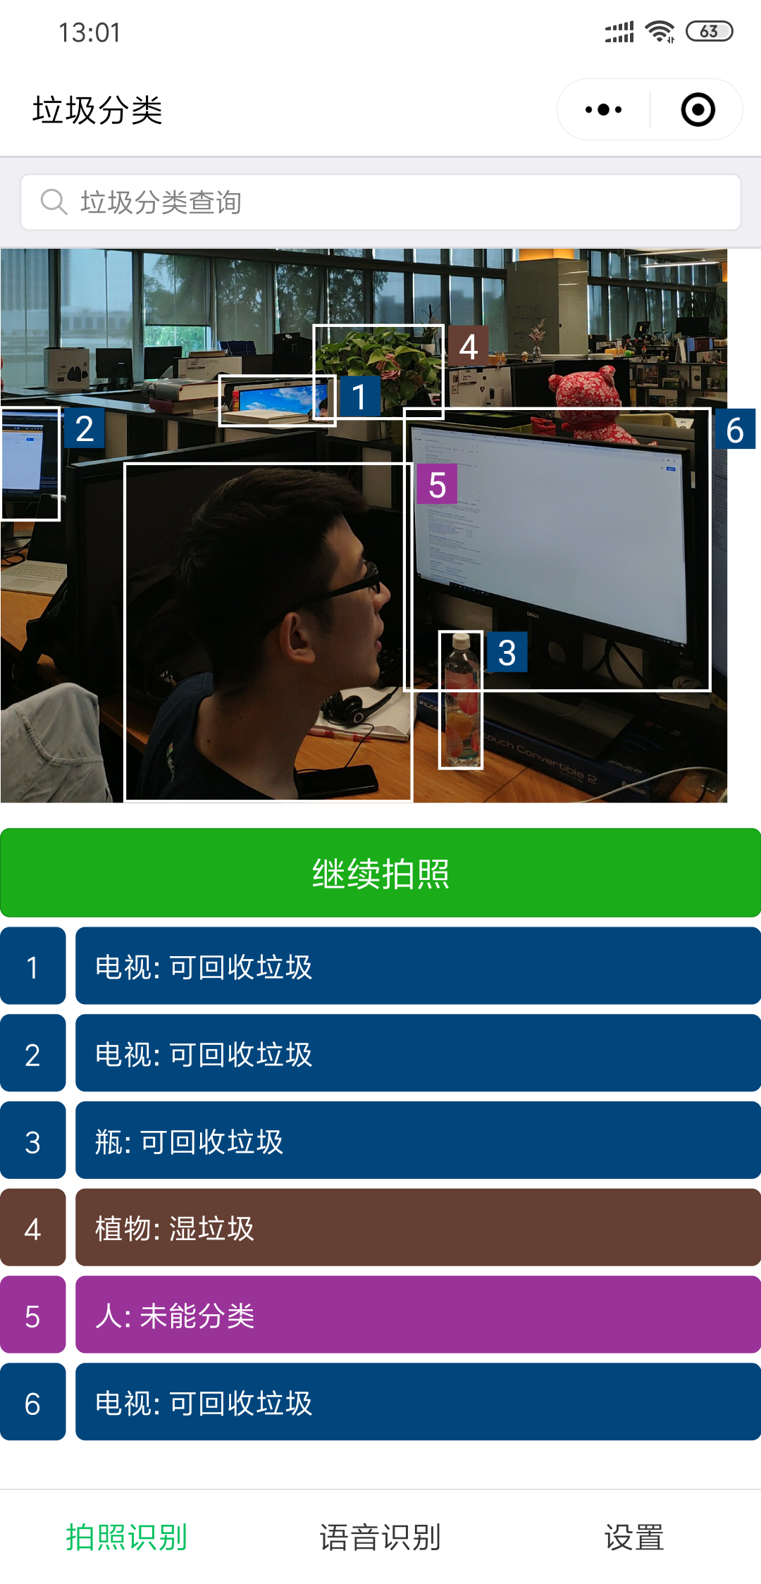
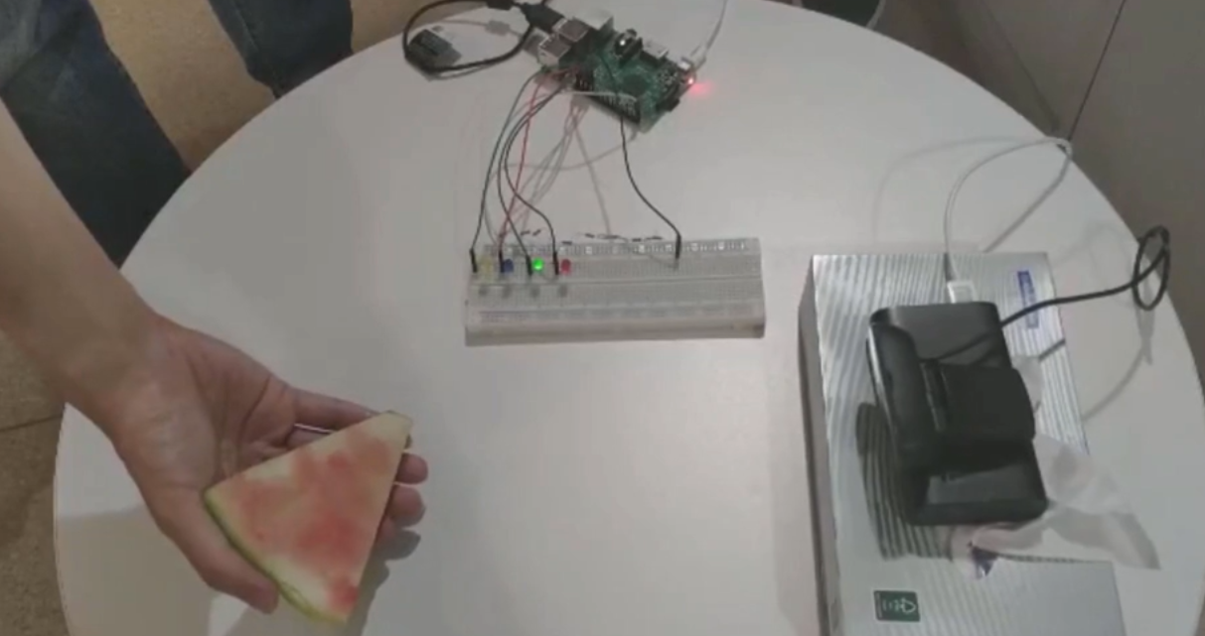
The biggest impact ever
We support both!
ToC: WeChat Mini Program
ToB: AI on the Edge

Slide 7
Impact for ToC

Slide 8
AI as a Service
Mini Program
Web
Native App
AI as a Service

Slide 9
For all ToC customers Any Customer Any Platform
H5
iOS
Andriod
微信小程序
百度小程序
支付宝小程序
快应用
字节跳动小程序
QQ 轻应用

Slide 10
Impact for ToB

Slide 11
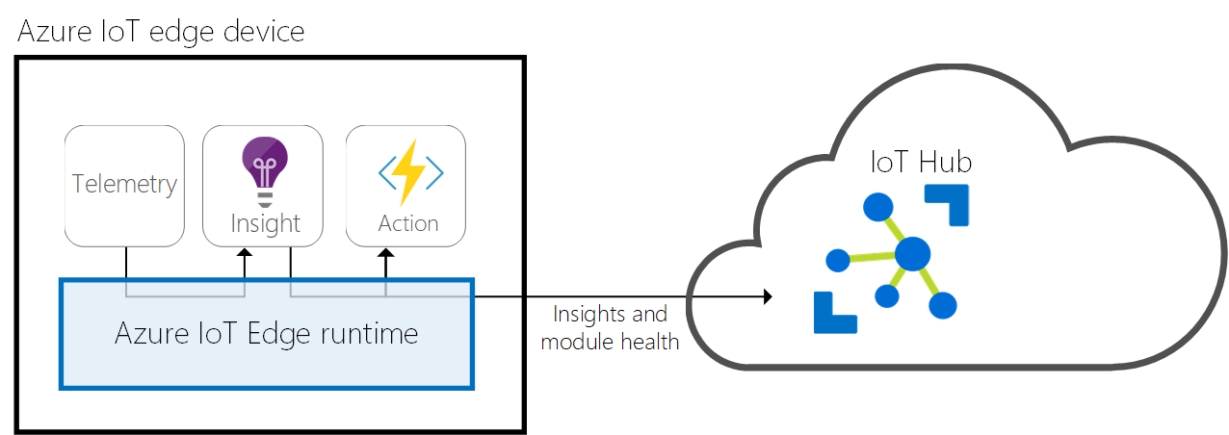
What does Enterprise/Government care about?
Latency: Cognitive Services APIs may take several seconds.
Data Privacy: Is the personal information in express delivery safe?
Cost: It is always the biggest concern of ToB customers.
Deployment At Scale: Deploy millions of devices in second.
Run Without Network Access: Could devices run in offline mode?

Slide 12
A portable solution
Works with any Linux or Windows devices that support container engines
AMD64
ARM32v7
ARM64

Slide 13
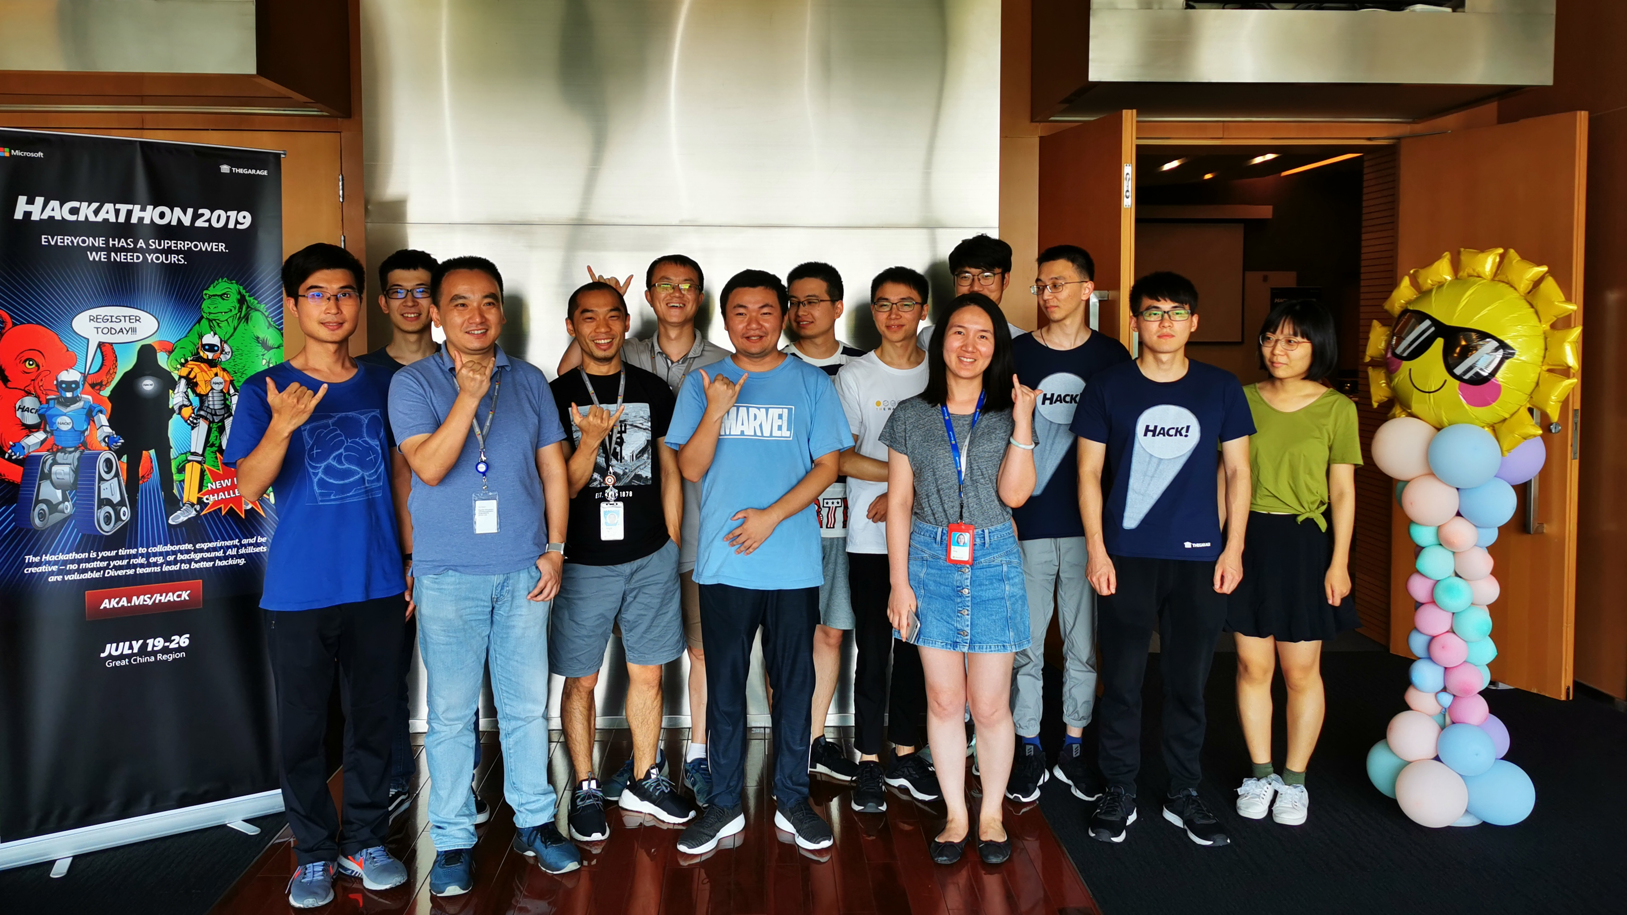
One Microsoft

